Slide 1

Welcome!!!

Slide 2
Admission Test System
Group : 03
Md. Shahariar Rahman ID : 170201061
Md. Redwanul Hassan Tanjim ID : 170201053
Md. Nasim Reza ID : 170201057
Md. Atiq Aziz ID : 170201027
Submitted To
Fatima Jahan Sarmin
Lecturer,
Dept. Of CSE, BAUST.

Slide 3
INTRODUCTION
Admission test is a required selection method of the universities. Although it doesn’t measure the brilliance of any student, but it’s a very important process in current situation of our country. Our software is one of the best solutions . It ensures all the processes of admission test.

Slide 4
OBJECTIVES
To Get Rid Of The Traditional Admission System.
To Ensure All Those Candidates To Appear In The Exam Who Wish To.
To Save Time And Money.
To Finish Every Steps Of Admission System With Just One Software.
To ensure the admission test for all applicants with total GPA of 8.00. Here marks don’t matter

Slide 5
FEATURES

Slide 6
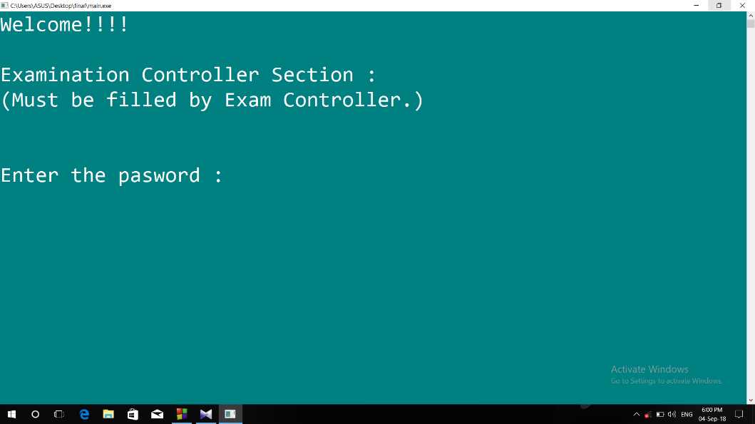
FEATURE-1
THIS SECTION IS PASSWORD PROTECTED.
HERE, ONLY 3 TRIALS ARE AVAILABLE.

Slide 7
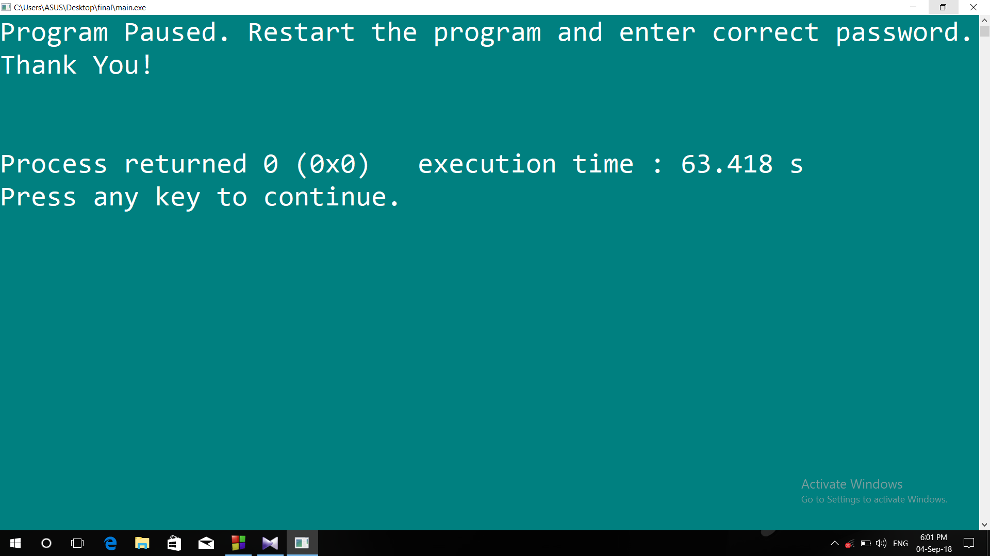
FEATURE-2
After 3 invalid trials, the program is stopped and it has to restart.

Slide 8
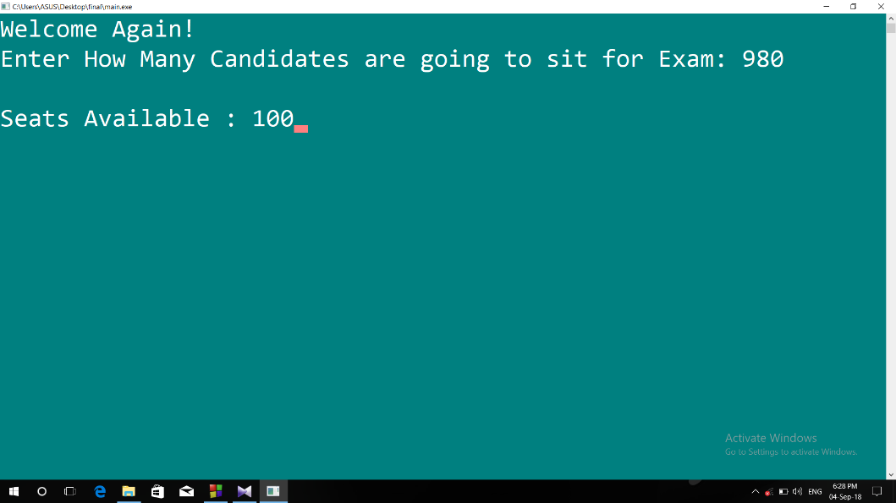
FEATURE-3
This section lets the exam controller enter the number of participants and available seats.

Slide 9
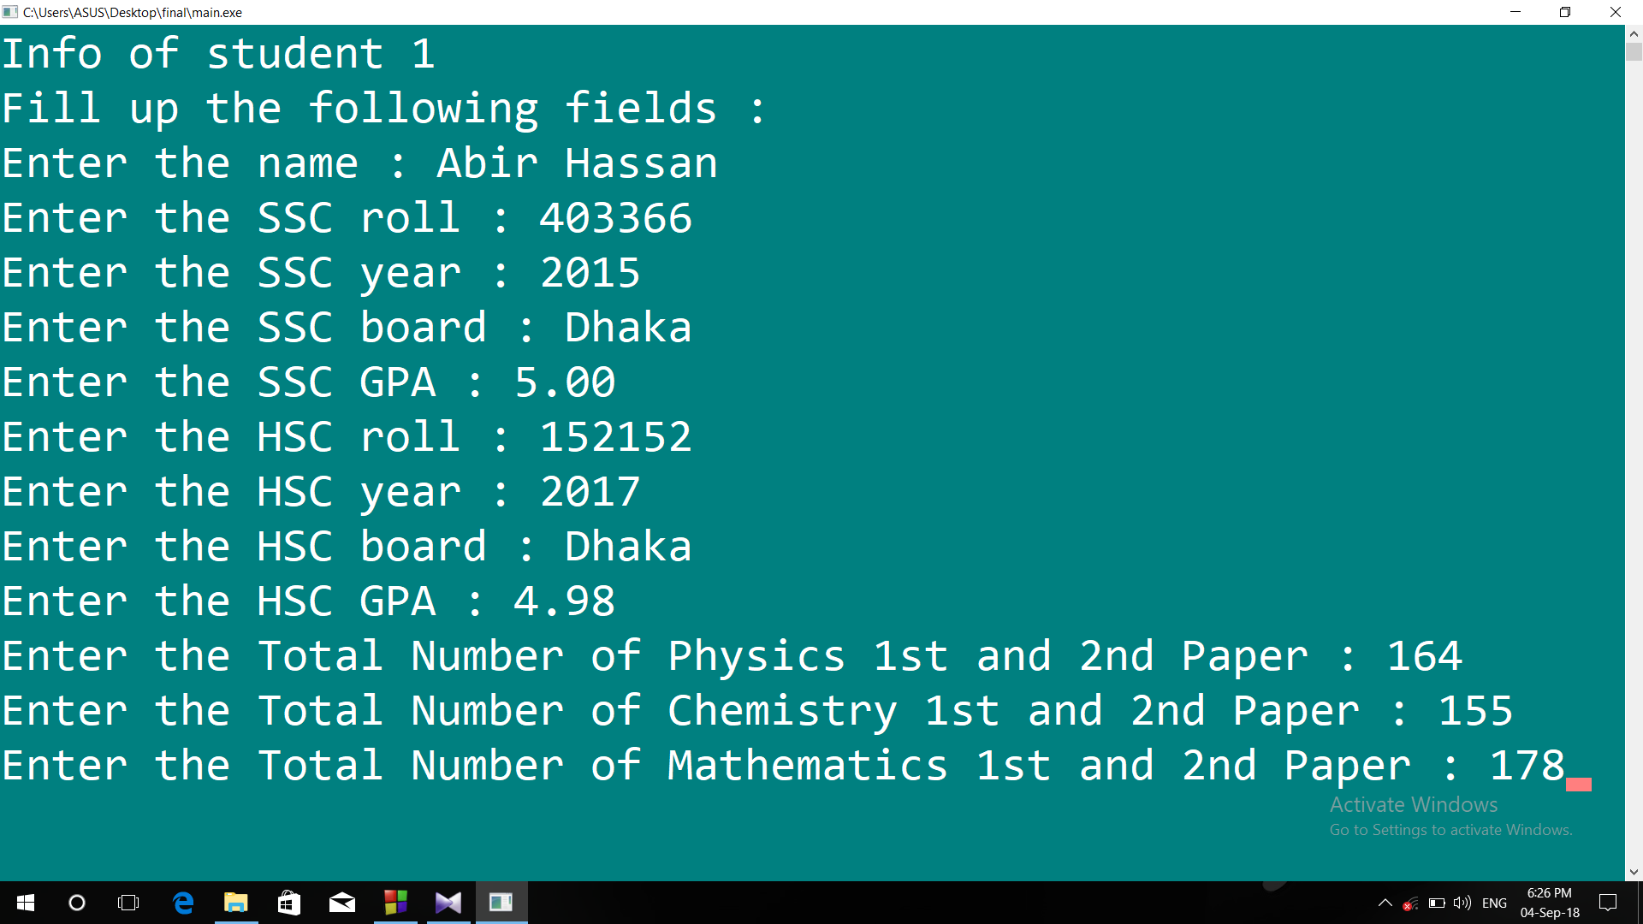
FEATURE-4
After the controller section, here comes the candidates’ section where they can appear in the test one by one.

Slide 10
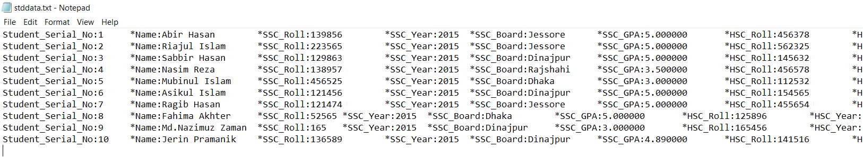
FEATURE-5
All the informations of all participants are stored in a text file including the ineligibles.

Slide 11
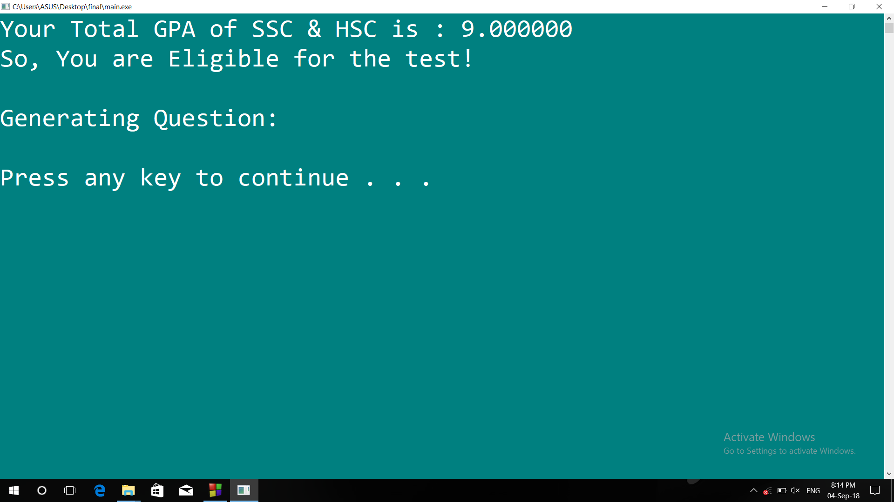
FEATURE-6
Candidates with total GPA (SSC+HSC) of 8.00 out of 10.00 will be eligible for the test.

Slide 12
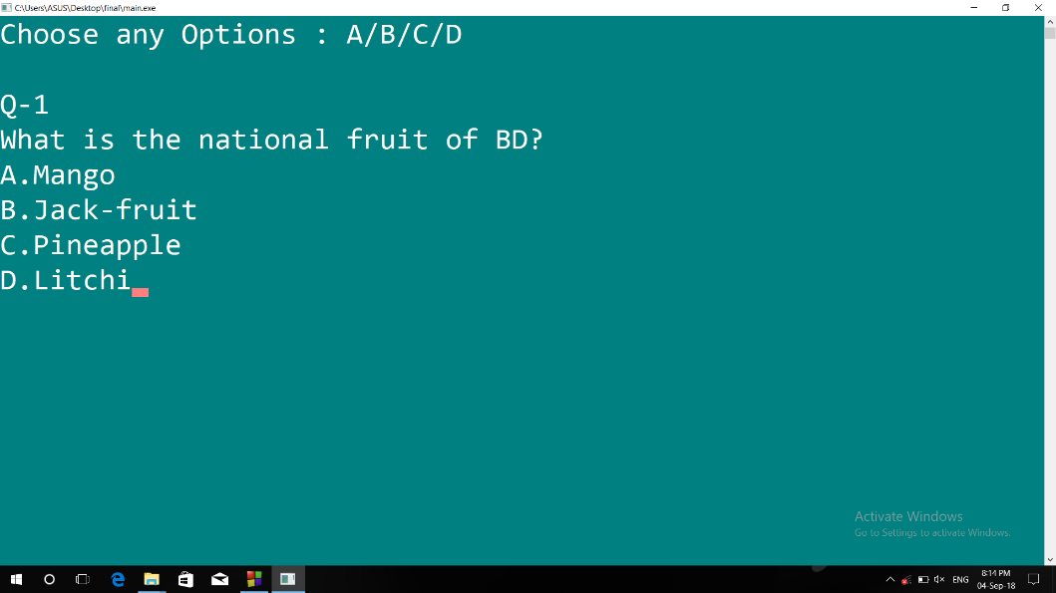
FEATURE-7
A few questions will be set for the test. Each correct answer will be considered as 1 mark . And each wrong answer will minus 0.5 mark from total obtained mark at the test.

Slide 13
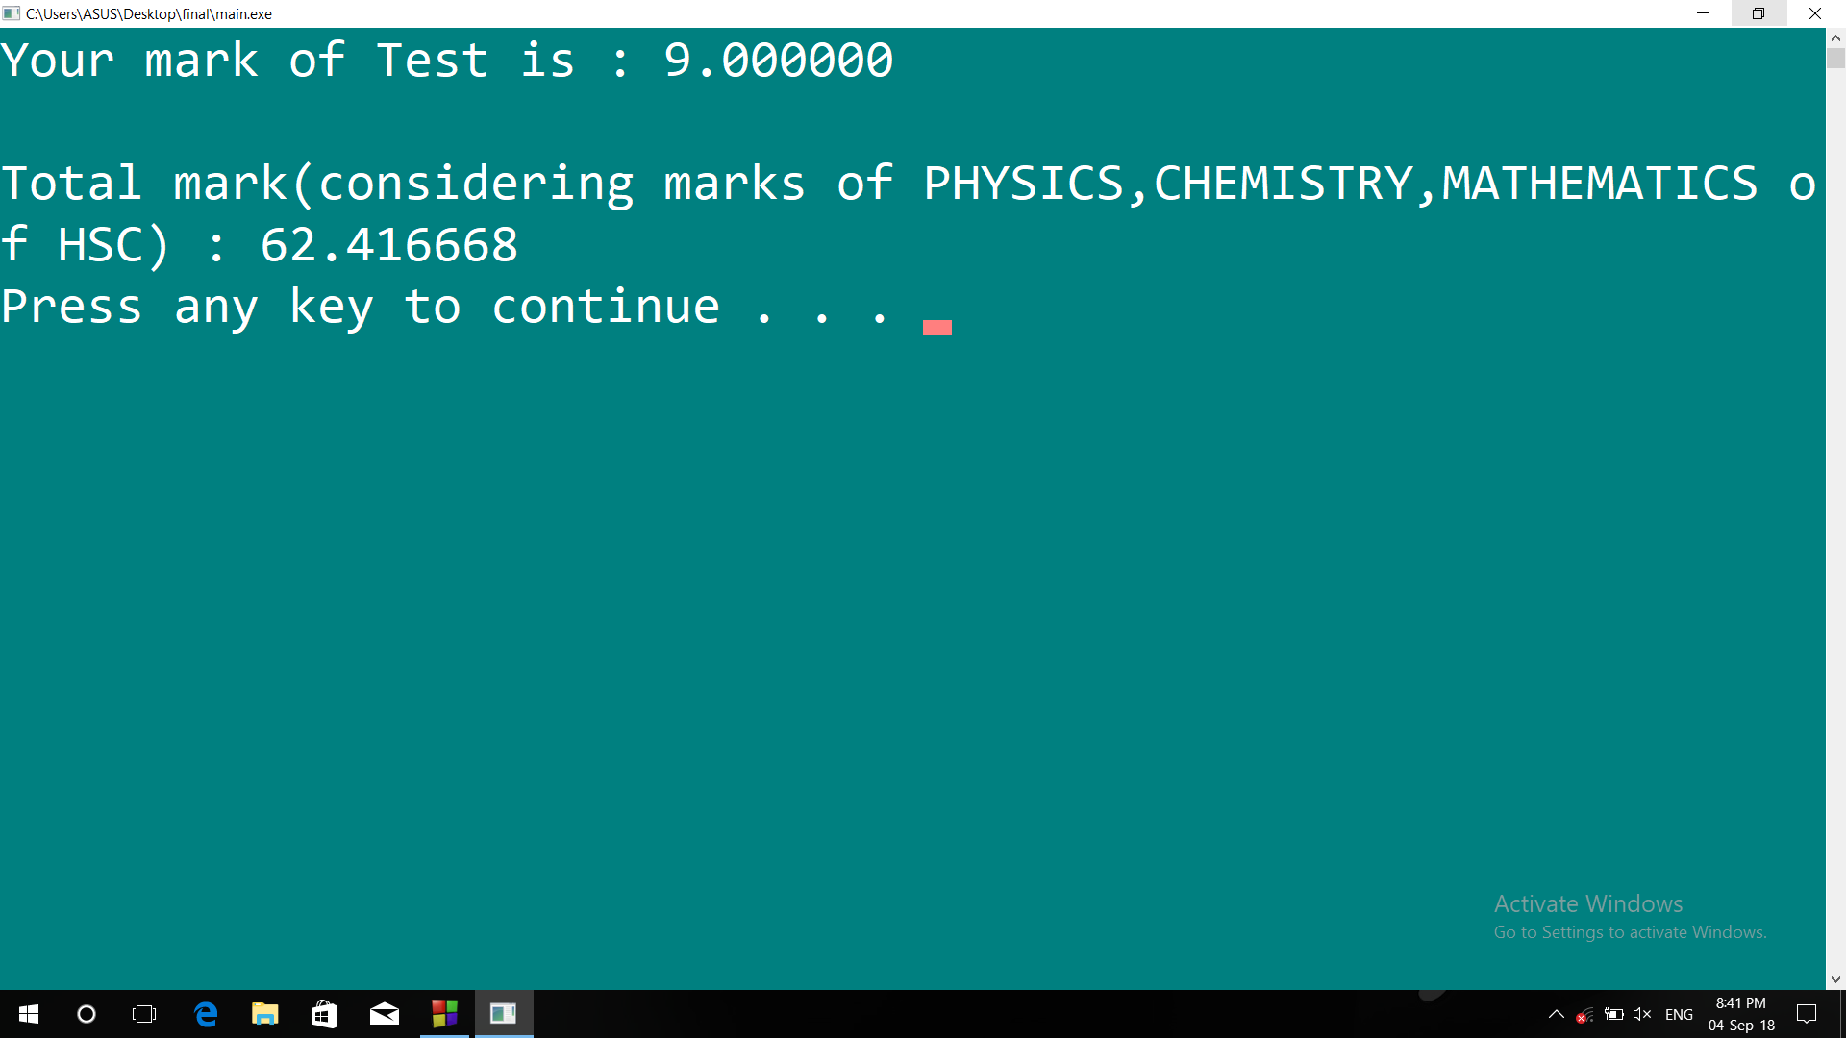
FEATURE-8
Obtained mark of the test will be converted into 90 and the total of the marks of Physic , Chemistry & Mathematics of HSC will be converted into 10. So, the exam will be held of 100 marks. Finally the converted obtained mark of test & the converted mark of HSC will be added together. It will be displayed.

Slide 14
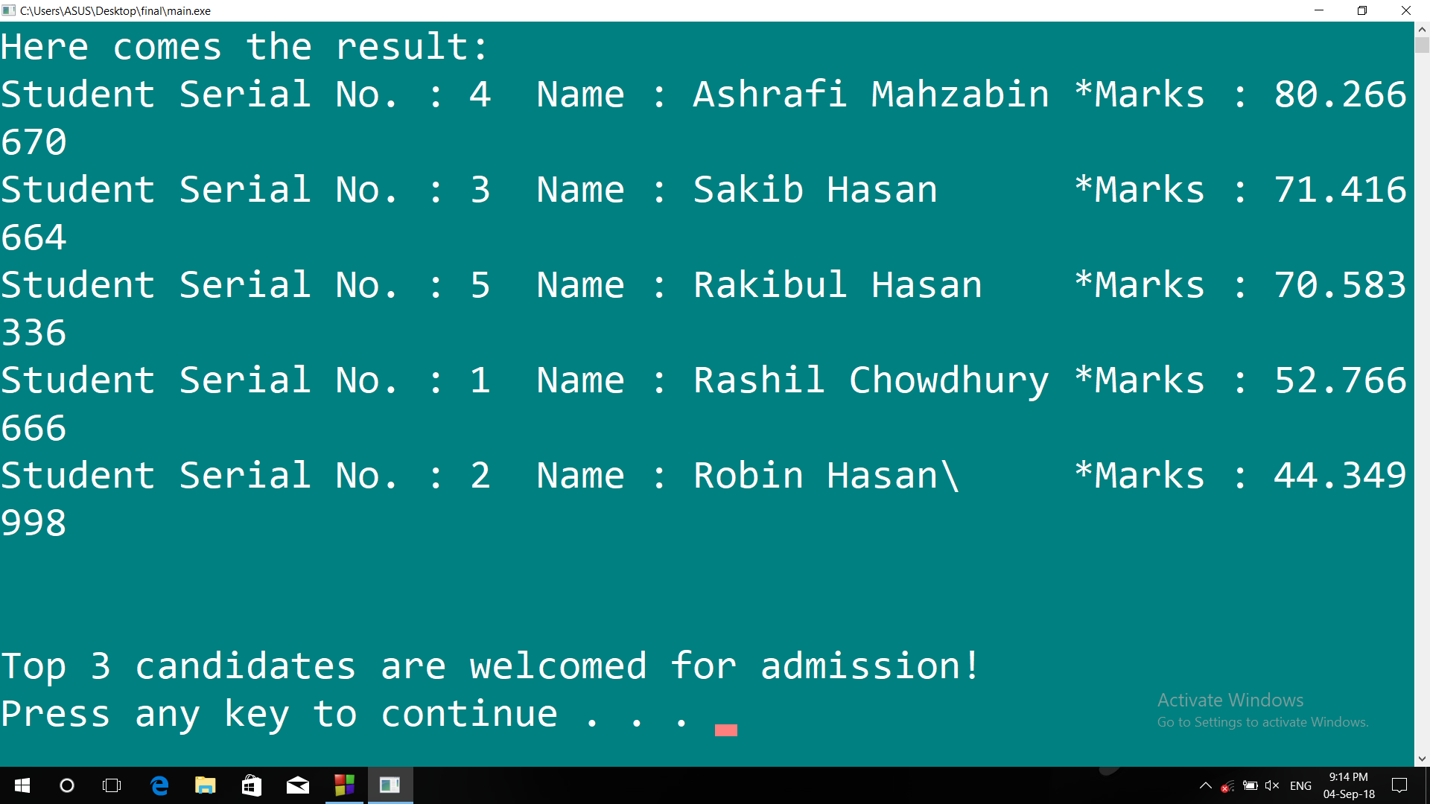
FEATURE-9
After ending the test of all candidates, the result will be appeared.
The achieved number will also be beside the name.
The numbers of welcomed students will be equal to the amount of available seats.

Slide 15
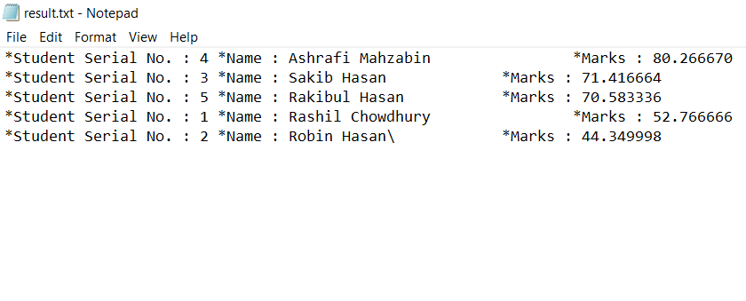
FEATURE-10
The result will be saved in a text file.

Slide 16
CONCLUSION
This is a software which will be useful and in the admission system. Taking exam in the random system have many difficulties .but with this software we can overcome all the difficulties. It will save time, money,. With just one click we will be able to get every details about a student and his exam results.

Slide 17
THANKS!!!

